Slide 1
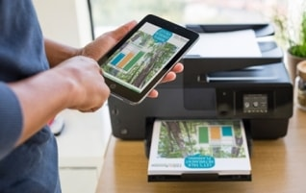
Provide immediate, secure and reliable Remote Printing for your users.
Every day, organizations of all sizes need to securely print from one location, such as the main office to another remote location that isn’t on the same network or even in the same country.
What you need is an efficient remote printing solution that works quickly and seamlessly, while keeping IT investments relatively low without compromising security…
The TSplus Virtual Printer is the convenient remote printing solution to setup on your server. It enables print data delivery and release between multiple networks to a local printer over a TSplus remote connection.
The Virtual Printer detects and maps the list of local printers to the server exactly as if they were directly connected. Users experience a smooth, trouble-free printing process - just like if they were printing locally!
For businesses that need to securely send and print documents between offices in multiple locations or employees who want to print work documents when working from home, the Virtual Printer offers a practical remote printing solution.
Setting up remote printing is quick and easy: The TSplus Virtual Printer is driverless and requires little configuration. Once both server and client components are installed, it takes only two clicks to print from your remote session to the local printer of your choice.
The TSplus Virtual Printer is the adaptable and cost-effective remote printing solution to reduce hardware investment and ease network printing management!

Slide 2
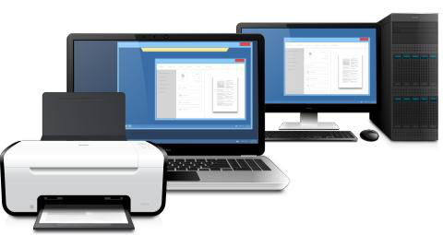
Secure Remote Printing.
TSplus Virtual Printer is bound by your organization’ security: The print jobs are run within the corporate network and benefit from all security measures already in place such as user authentication, data encryption, transmission encryption. Print any file securely stored on your corporate network with confidence that your data will stay safe.
Printing with TSplus Virtual Printer is an isolated process which works per individual session, so there is no risk of confidential information leaks.
Fast Remote Printing.
Remote printing eliminates the need for laborious email attachments. The Virtual Printer works by reducing size of print jobs, which greatly simplifies the process. TSplus Virtual Printer speeds up data transfer for a fast and high-quality printing job. Get instant printing from anywhere!
Flexible Remote Printing.
TSplus Virtual Printer adapts to your needs to save you time and money: compatible with all brands of printer, it works both in single and multi-users environments!
Benefit from both standard and specific printing features with the best quality: color & resolution; paper size, orientation…
3 Editions are available (license/server):
Virtual Printer is compatible with the following environments:
Up to 5 users.
TSplus Generated RDP Client, RemoteApp, Web Portal plugin
Up to 10 users.
Windows 32 and 64-bits.
Unlimited number of users.

